Slide 1
Introduction and Security Principles
ITIS 6200/8200 Fall 2023

Slide 2
Today’s Cunning Plan (First half): Introductions & Logistics
Staff introductions
Course overview:
What will you learn in this class?
Course logistics
Lectures, office hours, exams, and grading
Resources and communication platforms
Collaboration and academic integrity
Inclusive learning
Stress management and mental health
Ethics
Non-discrimination

Slide 3
Staff Introductions

Slide 4
Who Am I? Professor Xiang (shaang) (he/him)
Did my undergrad in China
Electronic Engineering
Did a PhD at University of Virginia (UVa)
Research focus: formal methods; dependability
Advisors: John Knight
Did a 5 year Postdoc at Harvard University
Research focus: formal methods for security; information flow analysis; Cyber-physical systems
Advisors: Stephen Chong
First-year assistant professor in SIS
First time teaching a complete class, so your feedback/advice/complaints are appreciated!

Slide 5
Our TAs!
Vineeth Mylavarapu (Linkedin, email)
Master Student of Cyber Security
Tarun Grandhi (Linkedin, email)
Master Student of Computer Science

Slide 6
Course Overview

Slide 7
Learning Objectives
Understand fundamental concepts of security
Understand security vulnerabilities, threats and their significance
Understand how attacks work in practice
Understand security properties, and build computer systems with robust security properties
What mistakes not to make!
Notes:
“If I find out you start a new project in C or C++, or use unescaped SQL, or allow your web site to support CSRF attacks… MY SPIRIT WILL REACH THROUGH YOUR MONITOR AND STRANGLE YOU!!!!” ~Nick

Slide 8
Course Outline
Introduction to Security
What are some general philosophies when thinking about security?
Cryptography
How do we securely send information over an insecure channel?
Web Security
What are some attacks on the web, and how do we defend against them?
System Security
What are some attacks on computer systems, and how do we defend against them?
Assurance of Security
How to establish/prove security properties for computer systems? (My research)
Miscellaneous Topics
Useful, interesting, or fun topics. Maybe some guest lectures! e.g., CPS security

Slide 9
Extra Tools and Skills
Some non-security-related skills you can take away from this class:
Cryptography
Becoming a better consumer: be able to analyze security products and pick the right security tools for your software
Web Security
Software engineering: understand how websites are built and how your web browser interacts with remote web servers
System Security
Architecture and OS: understand how the memory works and how your software applications interact with OS and hardware
Assurance of Security
Mathematical notations, system modeling, and proof methods

Slide 10
Prerequisites
No prior course requirement; but the following skills help
Familiarity with basic mathematical notation and proof structures
Relevant for cryptography
Relevant for assurance of security
Familiarity with memory layouts and assembly
Relevant for system security
An ability to pick up new programming languages quickly
Projects may need it
Notes:
61C: It's possible to do well in the class even if you did poorly in 61C or didn't take 61C!
Programming languages: As an upper-division class, we will be holding your hand less and trusting you to get your hands dirty on your own

Slide 11
Course Logistics

Slide 12
Enrollment
Course staff does not control enrollment; we have to follow department policy
For course registration issues, please contact Katie Watson at katie.watson@charlotte.edu

Slide 13
Course Structure: Lectures
This is a in-person class, you are expected to be here!
Attendance is not taken
Tuesday/Thursday, 10:00–11:15 AM
Using electronic devices not allowed except for learning purposes

Slide 14
Course Structure: Office Hours
Space to ask questions about content, get help with projects, raise concerns with the course, etc. with a TA or instructor
All office hours start next week (week of August 28)
My office hours will be in person
Tu,Th 1:15-2:30pm, Woodward Hall 330d
TA’s office hours be available both in-person and online
Vineeth Mylavarapu: Monday 7-8pm; COED-065, College of Education
Tarun Grandhi: Wednesday 6-7pm; Woodward Hall, 309
Office hours details are available in a Google calendar at:
The canvas site
And my webpage: https://www.jianxiang.info/teaching/ITIS6200/2023fa/officehours.html

Slide 15
Platforms
Canvas
Course information, e.g., schedule, office hours, policies
Distributions / submission of assignments and projects
Post questions at Discussion forum
Email
itis6200-staff@uncc.edu for questions and issues related to assignments, course content, etc.. The course staff will closely monitor this email.
sending email to individual course staff will delay a response.
It may take up to 48 hours to respond

Slide 16
Textbooks
No textbook is required, but if you would like additional references, we recommend:
Security Engineering by Ross Anderson
Cryptography Engineering by Ferguson, Schneier, and Kohno
Introduction to Computer Security by Matt Bishop
Computer Security: Principles and Practice by William Stallings
Computer Security: Art and Science by Matt Bishop
Security in Computing by Charles P. Pfleeger
Introduction to Computer Security by Michael Goodrich and Roberto Tamassia
Computer Security, a freely available course textbook from UC Berkerly.
Notes:
We wrote this textbook ourselves to supplement lecture content

Slide 17
Course Structure: Exams
Closed book exams
Midterm
Tentatively Thursday, Sep 28th, 10:00-11:15 AM
Final
Thu 14-Dec, 8:00 - 10:30am

Slide 18
Grading Structure (Tentatively)
Homework: 40%
Complete individually
For now, 4 homework in total
Projects: 15%
Complete individually
For now, 2 projects in total
Midterm: 20%
Final: 20%
Participation: 5%
Includes attendance and participation in class and office hours, and contributing to online discussion
(Late policy next)

Slide 19
Class Policies: Late policy
Submission
Must be submitted on Canvas.
Assignments are due by 11:59PM on the due date.
Late policy
No late submissions, except for special circumstances such as accident, illness or death in the immediate family, in which case you must give us notice or proof. Late submissions will be discussed on a case-by-case basis.
To request late submissions, please send emails to itis6200-staff@uncc.edu.

Slide 20
Class Policies: Inclusive Learning
Are you facing barriers in school due to a disability?
Office of Disability Services
University Center for Academic Excellence
Our goal is to teach you the material in our course. The more accessible we can make it, the better.

Slide 21
Class Policies: Collaboration
Asking questions and helping others is encouraged
Discussing course topics with other is welcome!
But make sure you can walk through the problems yourself
The answers you submit for evaluation must be results of your own efforts.
Limits of collaboration
Don’t share solutions with each other
You should never see or have possession of anyone else’s solutions—including from past semesters
Do not look on the web or generative AI for solutions (unless we say so in the assignment and projects)

Slide 22
Class Policies: Academic Integrity
Academic integrity policies
Any form of cheating will receive 0 point in that task and be reported to the University.
If you are ever in doubt, ask the course staff to clarify what is and isn't appropriate.
Students have the responsibility to know and follow the requirements of University Policy 407: The Code of Student Academic Integrity.
Do not pass solutions to problem sets nor accept them from another student.
Do not post course materials (including problem sets, solutions, exams, etc.) to websites or course-content archives.
No cheating will be tolerated! Copying from previous semesters, other students, or the Internet are prohibited!

Slide 23
Ethics
In this class, you will learn a lot about attacks out of necessity
To be able to defend against the attacker, you must learn the techniques that attackers use
It is usually okay to break into your own systems
This is a great way to evaluate your own systems
It is usually okay to break into someone else’s systems with their explicit permission
It is grossly unethical and exceedingly criminal to break into someone else’s systems without their permission

Slide 24
Non-Discrimination
No student will be discriminated against in this class based on age, race, nationality, religion, sexual orientation, gender identity/expression, veteran’s status, country of origin, or group affiliation.
Any student who does not behave in a respectful manner may be asked to leave the classroom.
Students with continuous or repeated disrespectful behavior will be referred to the Office of Student Conduct or the Title IX Office.

Slide 25
Stress Management and Mental Health
If you feel overwhelmed, there are options
Academically: Ask on Canvas, talk to staff in office hours, set up a meeting with staff to make a plan for your success this semester
Non-academic:
The Center for Counseling and Psychological Services line 704‑687‑0311 is a support line (with after hour support) for students who have mental health concerns, whether they are in immediate distress or not, on-campus or elsewhere.

Slide 26
Today’s Cunning Plan (Second half): Intro to Security
Introduction to security
What is security
Why is security important
Security principles

Slide 27
What is security?

Slide 28
What is security?
Enforcing a desired property in the presence of an attacker
data confidentiality
user privacy
data and computation integrity
authentication
availability
…

Slide 29
Why is security important?
It is important for our
physical safety
confidentiality / privacy
functionality
protecting our assets
successful business
a country’s economy and safety
and so on…

Slide 30


Why is security important?
Consider: Physical Safety
 | Link
FBI probe of alleged plane hack sparks worries over flight safety
Drew Harwell | May 18, 2015
 | Link
Pacemaker hack can kill via laptop
Jeremy Kirk | October 21, 2012

Slide 31


Why is security important?
Consider: Privacy/Confidentiality
 | Link
91 Percent of Healthcare Organizations Suffered Data Breaches in the Past Two Years
Jeff Goldman | May 12, 2015
 | Link
Data Breach Tracker: All the Major Companies That Have Been Hacked
Karavbrandeisky | October 30, 2014
In 2020, there were over 1001 breaches, affecting the data of 155,000,000 individuals
Notes:
Source: Identity Theft Resource Center

Slide 32


Why is security important?
Consider: National security
 | Link
America’s Electric Grid Has a Vulnerable Back Door—and Russia Walked Through It
Rebecca Smith and Rob Barry | January 10, 2019
A Wall Street Journal reconstruction of the worst known hack into the nation’s power system reveals attacks on hundreds of small contractors

Slide 33

What is hackable?
Everything!
Especially things connected to the Internet
Assume that every system is a target
A casino was hacked because a fish-tank thermometer was hacked within the network
 | Link
For the First Time, Hackers Have Used a Refrigerator to Attack Businesses
Julie Bort | January 17, 2014
Notes:
“If it can kill you, don’t connect it to the Internet!” ~Nick

Slide 34
Security Principles
Notes:
Soon, we will get into really technical details and attacks and learn to actually exploit (and defend) computer systems
But the rest of lecture will be focused on some of the philosophical concepts that underpin everything in the rest of the course

Slide 35
Security Principles
Security principles
Know your threat model
Consider human factors
Security is economics
Detect if you can’t prevent
Defense in depth
Least privilege
Separation of responsibility
Ensure complete mediation
Don’t rely on security through obscurity
Use fail-safe defaults
Design in security from the start
Notes:
We will start the study of security with some key principles in designing secure systems that we will use throughout the class. You will see them appearing in different scenarios across different parts of security.
Soon, we will get into really technical details and attacks and learn to actually exploit (and defend) computer systems
But the rest of lecture will be focused on some of the philosophical concepts that underpin everything in the rest of the course

Slide 36
Know Your Threat Model

Slide 37
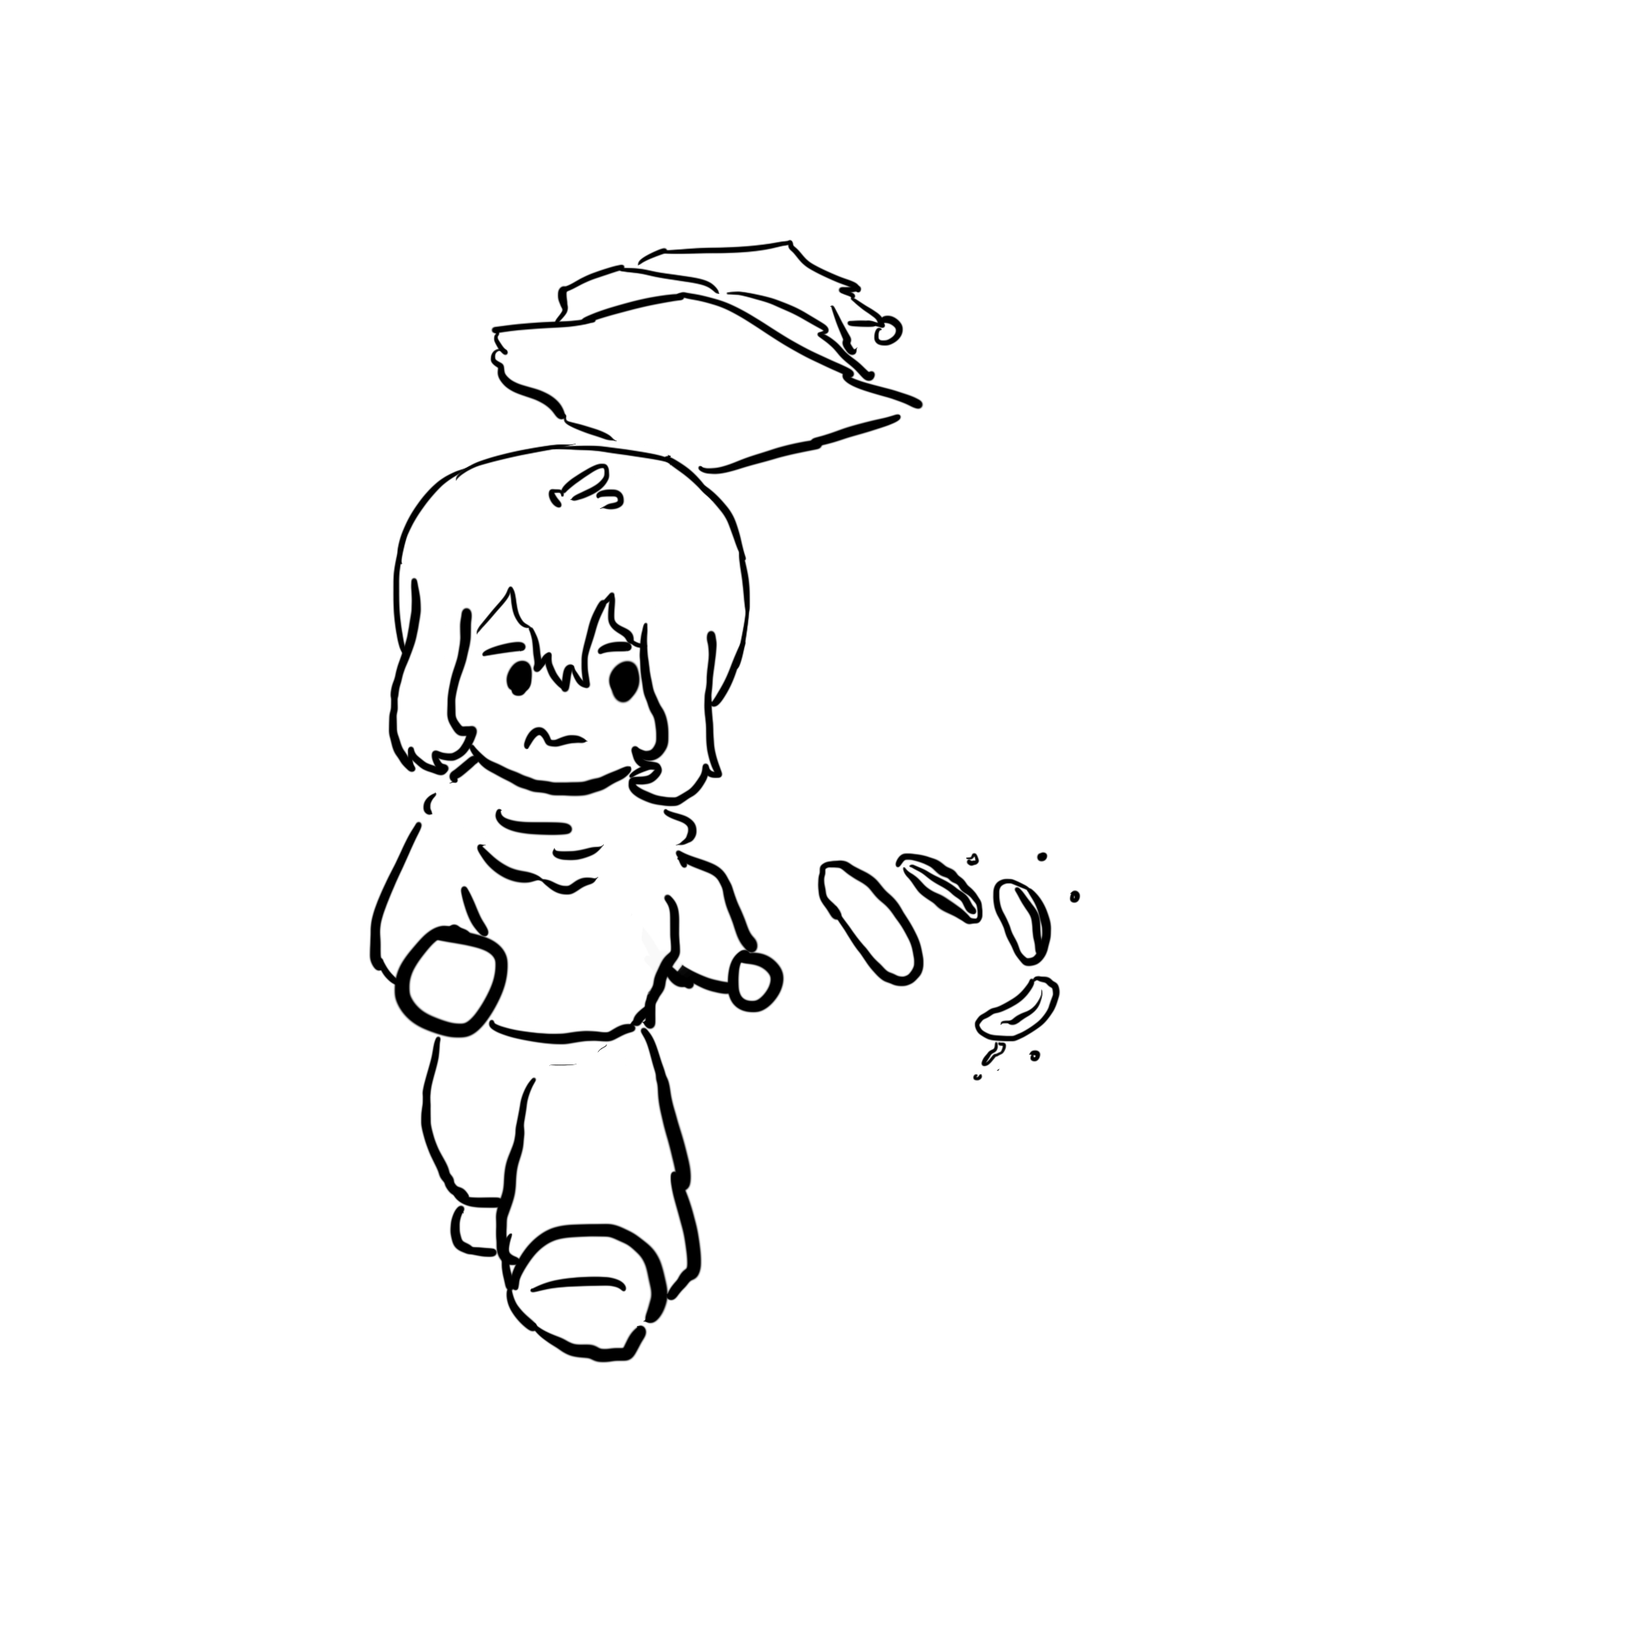

The Parable of the Bear Race
Blue slides are stories and case studies; the key is the takeaways
“I don’t have to outrun the bear. I just have to outrun you.” Takeaway: You often just need to have “good enough” defense to make attackers turn somewhere else.
Notes:
“Two hikers are out in the woods, going for a walk. Up behind them comes a huge grizzly bear, rising up and roaring at them. One hiker, really scared, goes ‘Oh god, oh god, it’s a bear, what are we going to do?’ The other hiker calmly takes off his pack and starts to tie his shoes. The first hiker says to the first, ‘Why are you not worried?’ The second hikers says, ‘You know, I don’t have to outrun the bear. I just have to outrun you.’”

Slide 38




Security Principle: Know Your Threat Model
Threat model: A model of who your attacker is and what resources they have
It all comes down to people: The attackers
No attackers = No problem!
One of the best ways to counter an attacker is to attack their reasons
Why do people attack systems?
Money
Politics
Fun
Watching the world burn
Notes:
“We are sick of playing whak-a-mole on bad guys… Instead we play whak-a-mole on bad-guy business models”

Slide 39
Security Principle: Know Your Threat Model
Consider: Personal security
Who and why might someone attack you?
Criminals might attack you for money
Teenagers might attack you for laughs or to win online games
Governments might spy on you to collect intelligence
Intimate partners might spy on you
This is a surprisingly dangerous threat model!
Notes:
Intimate partners: Consider their physical access, intimate knowledge, social engineering skills, and motivation to target a particular person
Turn your phone into a bug and location tracker: its easy if your phone is in their hands and they know the password...
A good summary from Karen Levy https://slate.com/technology/2018/03/apps-cant-stop-exes-who-use-technology-for-stalking.html

Slide 40
Threat Model: Common Assumptions for Attackers
Assume the attacker…
Can interact with systems without notice
Knows general information about systems (operating systems, vulnerabilities in software, usually patterns of activity, etc.)
Can get lucky
If an attack only succeeds 1/1,000,000 times, the attacker will try 1,000,000 times!
May coordinate complex attacks across different systems
Has the resources required to mount the attack
Can and will obtain privileges if possible
Notes:
Interacting with systems: You may not always detect the attacker probing your systems before launching an attack
Resources: The NSA can mount a larger-scale attack than an individual criminal
“We are sick of playing whak-a-mole on bad guys… Instead we play whak-a-mole on bad-guy business models”

Slide 41
Trusted Computing Base
Trusted computing base (TCB): The components of a system that security relies upon
Properties of the TCB:
Correctness
Completeness (can’t be bypassed)
Security (can’t be tampered with)
Generally made to be as small as possible
A smaller, simpler TCB is easier to write and audit.
Notes:
To get a precise threat model, you should know TCB

Slide 42
Consider Human Factors

Slide 43

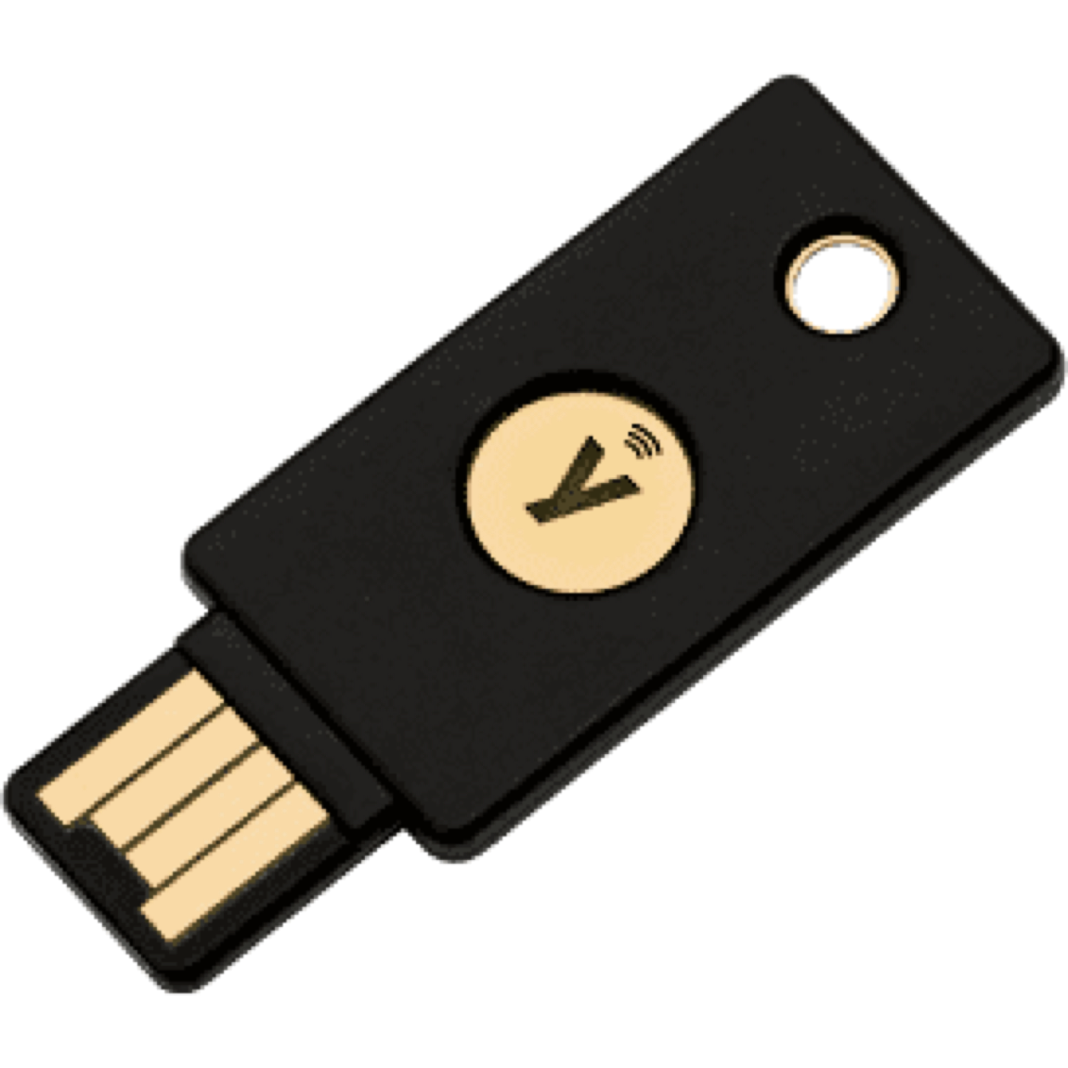
Security Principle: Consider Human Factors
It all comes down to people: The users
Users like convenience (ease of use)
If a security system is unusable, it will be unused
Users will find way to subvert security systems if it makes their lives easier
It all comes down to people: The programmers
Programmers make mistakes
Programmers use tools that allow them to make mistakes (e.g. C and C++)
It all comes down to people: Everyone else
Social engineering attacks exploit other people’s trust and access for personal gain
Physical security keys use the fact that humans are trained to safeguard keys
Notes:
“There is no patch for human stupidity”

Slide 44
Security is Economics

Slide 45
Security Principle: Security is Economics
Cost/benefit analyses often appear in security: The expected benefit of your defense should be proportional to the expected cost of attack
More security (usually) costs more
If the attack costs more than the reward, the attacker probably won’t do it
Example: You don’t put a $10 lock on a $1 item…
… unless a $1 item can be used to attack something even more valuable
Example: You have a brand-new, undiscovered attack that will work on anybody’s computer. You wouldn’t expose it on a random civilian
Notes:
Callback to exam security

Slide 46
Detect If You Can’t Prevent
Textbook Chapter 1.4

Slide 47
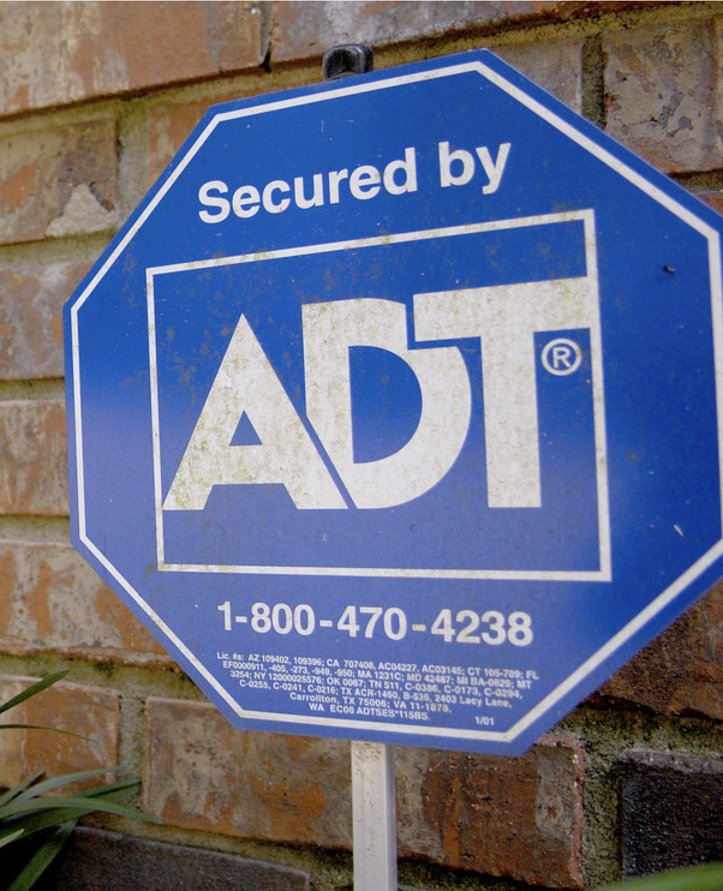
Burglar Alarms
Security companies are supposed to detect home break-ins
Problem: Too many false alarms. Many alarms go unanswered
Placing a sign helps deter burglars from entering at risk of being caught…
… even if you don’t have an alarm installed!
Takeway: Prevent attacks when you can, but detect them if you can’t

Slide 48
Security Principle: Detect if You Can’t Prevent
Deterrence: Stop the attack before it happens
Prevention: Stop the attack as it happens
Detection: Learn that there was an attack (after it happened)
If you can’t stop the attack from happening, you should at least be able to know that the attack has happened.
Response: Do something about the attack (after it happened)
Once you know the attack happened, you should respond
Detection without response is pointless!
Notes:
Callback to exam security (again)

Slide 49
Defense in Depth

Slide 50
Security Principle: Defense in Depth
Multiple types of defenses should be layered together
An attacker should have to breach all defenses to successfully attack a system
However, consider security is economics
Defenses are not free.
Defenses are often less than the sum of their parts

Slide 51
Least Privilege
Textbook Chapter 1.6

Slide 52
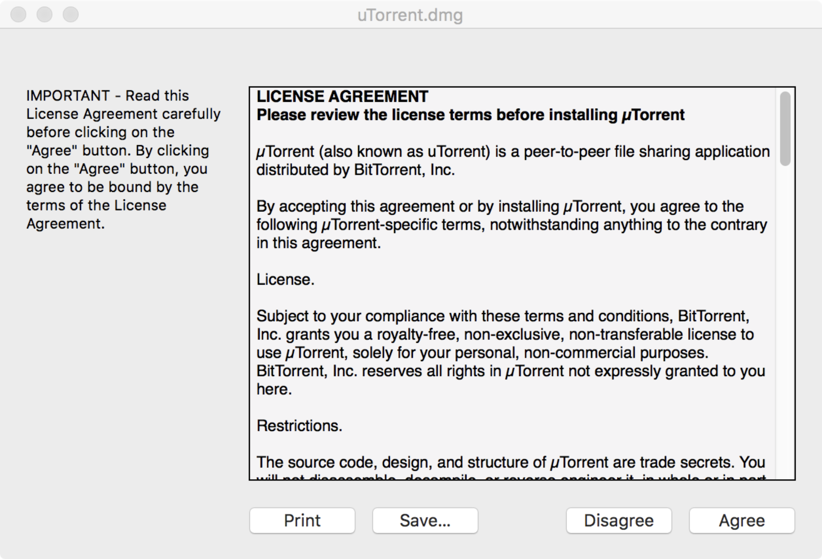
uTorrent

Slide 53
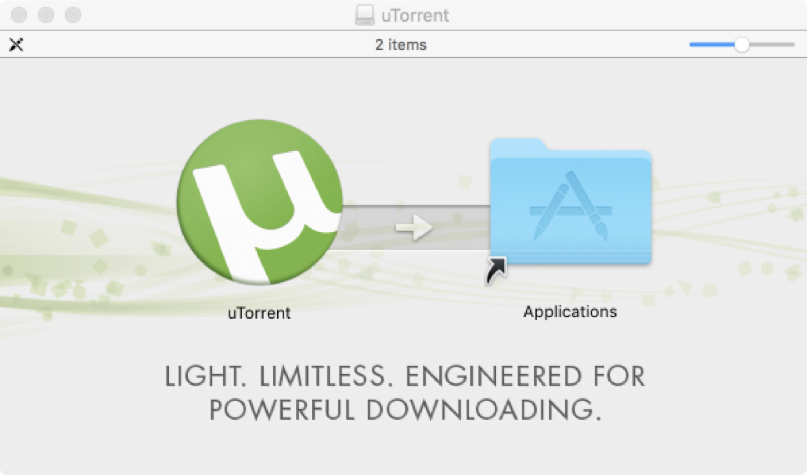
uTorrent

Slide 54
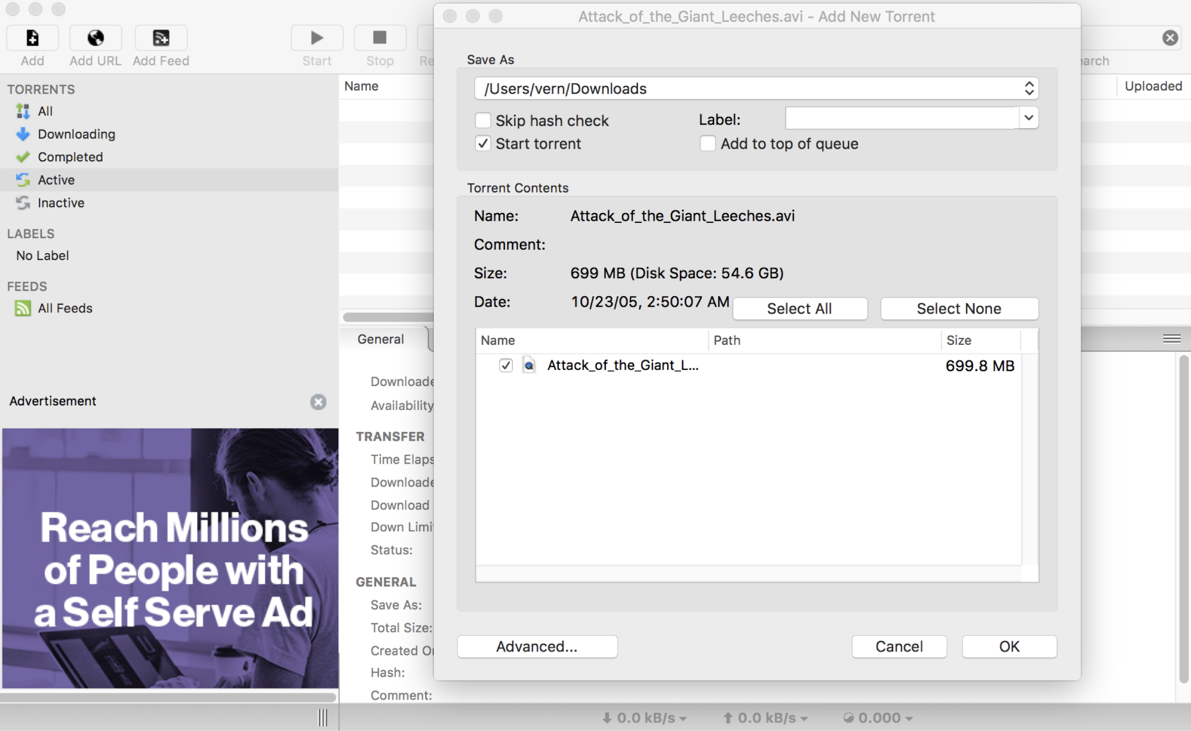
uTorrent
What was this program able to do?
Leak your files
Delete your files
Send spam
Run another malicious program
What does this program need to be able to do?
Access the screen
Manage some files (but not all files)
Make some Internet connections (but not all Internet connections)
Takeaway: Least privilege

Slide 55
Security Principle: Least Privilege
Consider what permissions a entity or program needs to be able to do its job correctly
If you grant unnecessary permissions, a malicious or hacked program could use those permissions against you

Slide 56
Separation of Responsibility

Slide 57
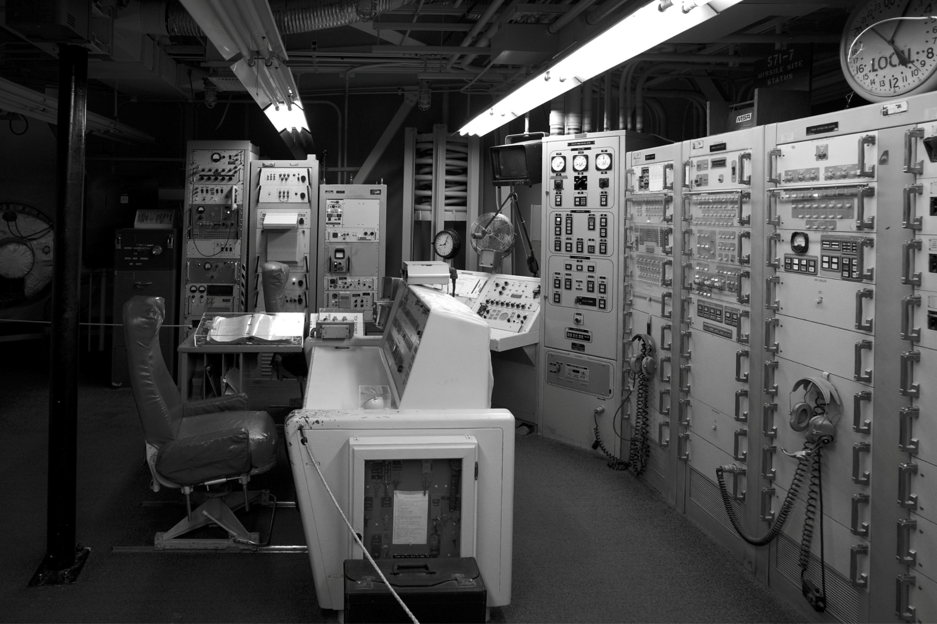
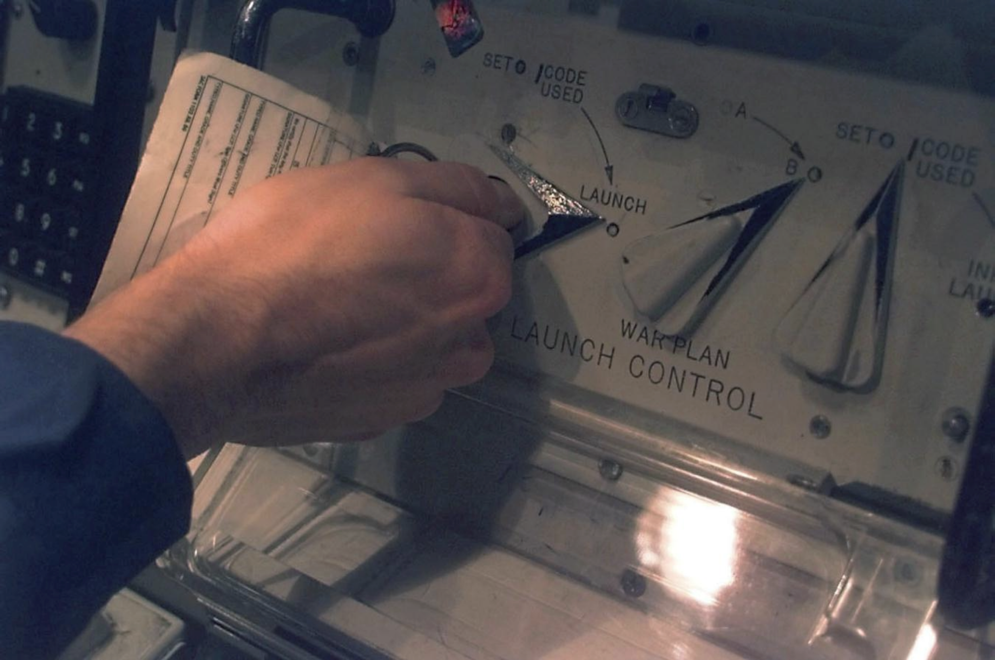
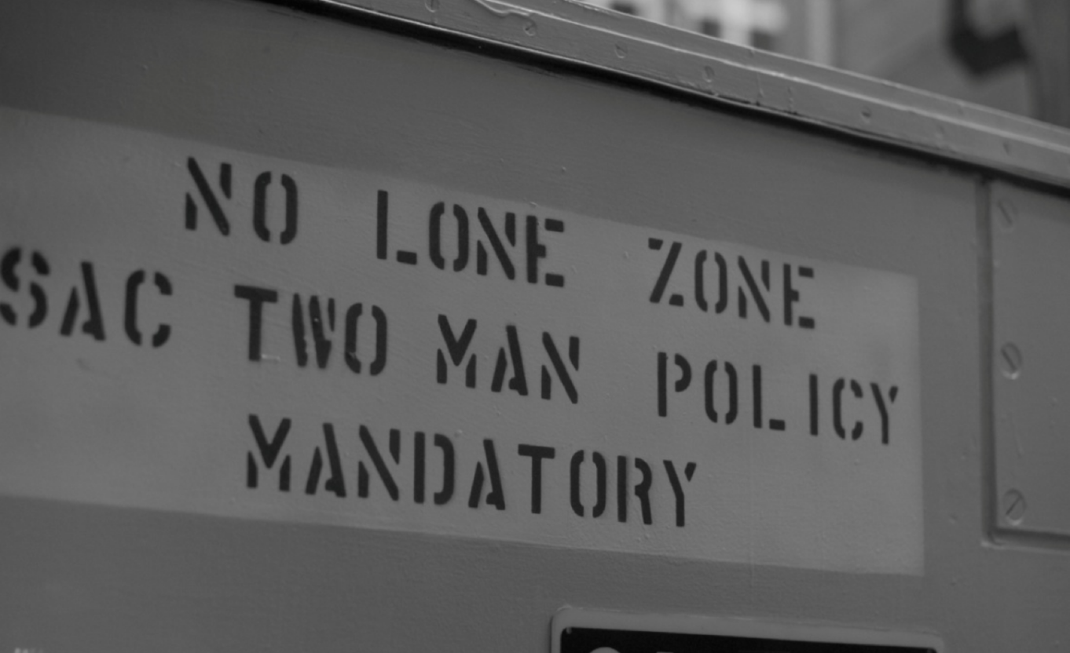

Welcome to a Nuclear Bunker
Notes:
This is a picture from a missile silo housing dozens of nuclear intercontinental ballistic missiles. In particular, this is the launch control center. The US missile command was quite understandably concerned about preventing unauthorized launch of a nuclear missile, and they implemented a number of steps to reduce this risk. This picture hints at one of the key defenses: dual-man control. You can see two chairs – there are two control panels for two launch officers. To launch the missiles, each officer has to set their console to launch – you can’t quite see it, but you need to insert a key to turn it to launch, and each officer has their own key that works only in their own console, which they keep on their person at all times. Notice the sign. No one person should ever be alone with a nuclear missile (to prevent them from manually launching it).
What security principle are we relying upon, to prevent unauthorized launches?

Slide 58
Security Principle: Separation of Responsibility
If you need to have a privilege, consider requiring multiple parties to work together (collude) to exercise it
It’s much more likely for a single party to be malicious than for all multiple parties to be malicious and collude with one another

Slide 59
Ensure Complete Mediation

Slide 60
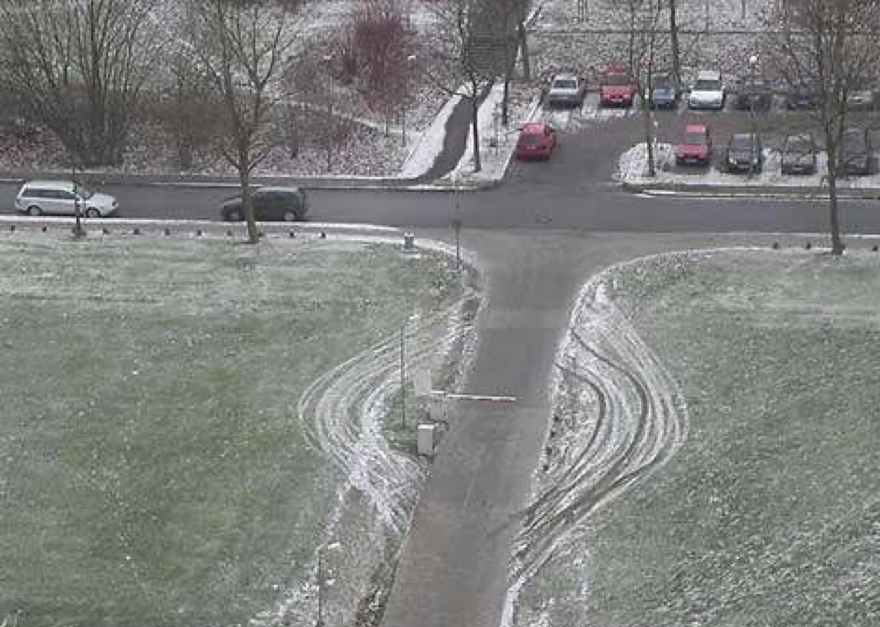
Spot the Issue

Slide 61

Security Principle: Ensure Complete Mediation
Ensure that every access point is monitored and protected
Reference monitor: Single point through which all access must occur
Example: A network firewall, airport security, the doors to the dorms
Desired properties of reference monitors:
Correctness
Completeness (can’t be bypassed)
Security (can’t be tampered with)
Should be part of the TCB
A common failure of ensuring complete mediation involving race conditions
The cars drove around the barrier

Slide 62
Time-of-Check to Time-of-Use
A common failure of ensuring complete mediation involving race conditions
Consider the following code:
procedure withdrawal(w)
// contact central server to get balance
1. let b := balance
2. if b < w, abort
// contact server to set balance
3. set balance := b - w
4. give w dollars to user
Suppose you have $5 in your account. How can you trick this system into giving you more than $5?

Slide 63
Time-of-Check to Time-of-Use
withdrawal(5) 1. let b := balance 2. if b < w, abort
withdrawal(5) 1. let b := balance 2. if b < w, abort
// contact server to set balance 3. set balance := b - w 4. give w dollars to user
Time
// contact server to set balance 3. set balance := b - w 4. give w dollars to user
The machine gives you $10!

Slide 64
Don’t Rely on Security Through Obscurity

Slide 65
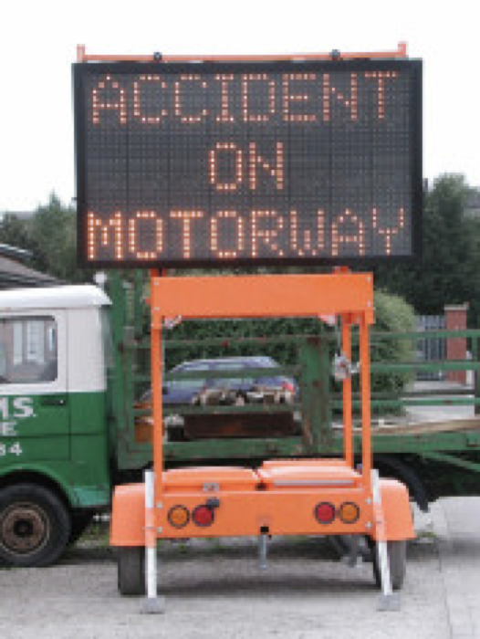
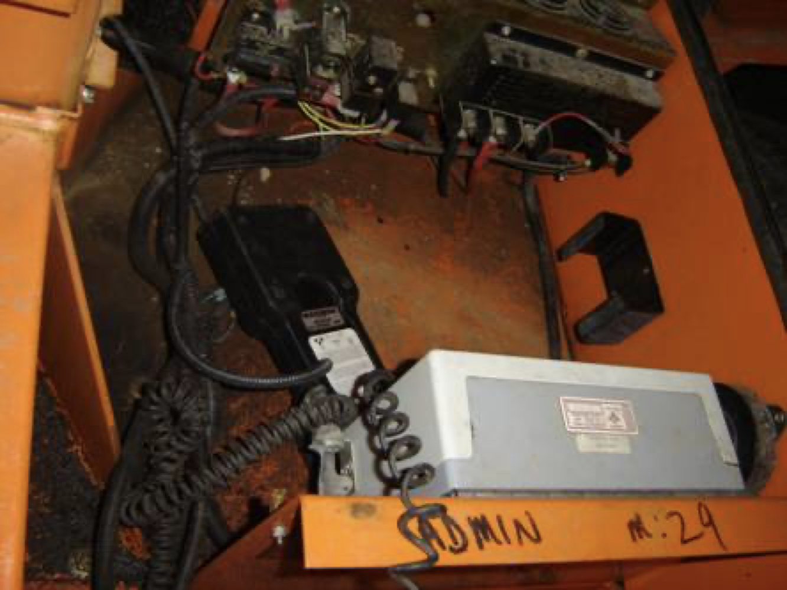
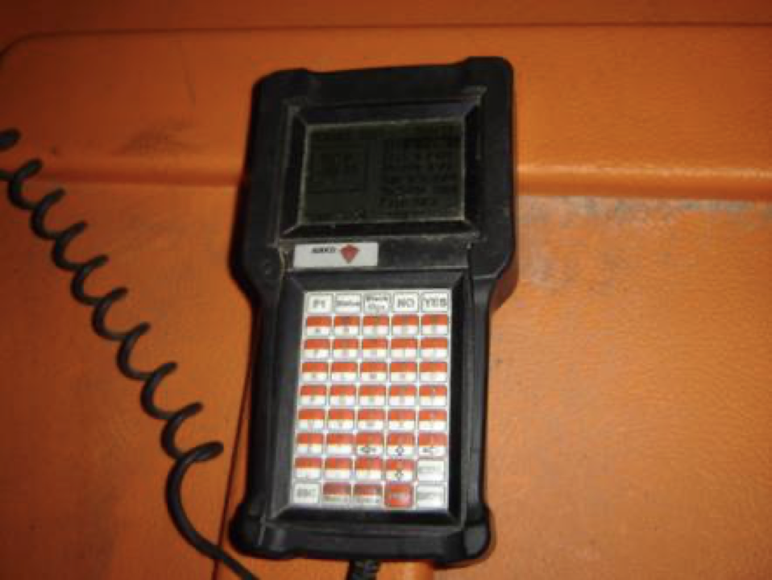
Accident on Motorway
Here’s the hidden computer inside the sign.
Here’s the control panel. Most signs use the default password, DOTS.
Here’s a highway sign.
Notes:
Ever see these road signs on the side of the highway? Well, they can be programmed to display any message. Internally, they contain a microcomputer. Road workers have to be able to enter a different message, which they can do after entering in a password. But then a hacker discovered that the default password is DOTS. And if the transportation dept has changed the default password, there’s a backdoor: you can reset the password to the default by entering DIPY.

Slide 66
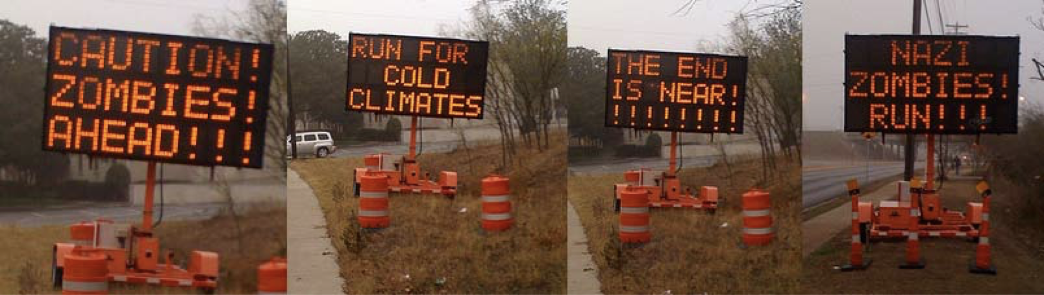
Caution! Zombies Ahead!!!
Takeaway: Shannon’s maxim/Don’t rely on security through obscurity

Slide 67
Security Principle: Shannon’s Maxim
Shannon’s maxim: “The enemy knows the system”
You should never rely on obscurity as part of your security. Always assume that the attacker knows every detail about the system you are working with (algorithms, hardware, defenses, etc.).
Assume the attacker knows where the “secret” control panel is located, and has read the manual with instructions on resetting the password.

Slide 68
Use Fail-Safe Defaults

Slide 69
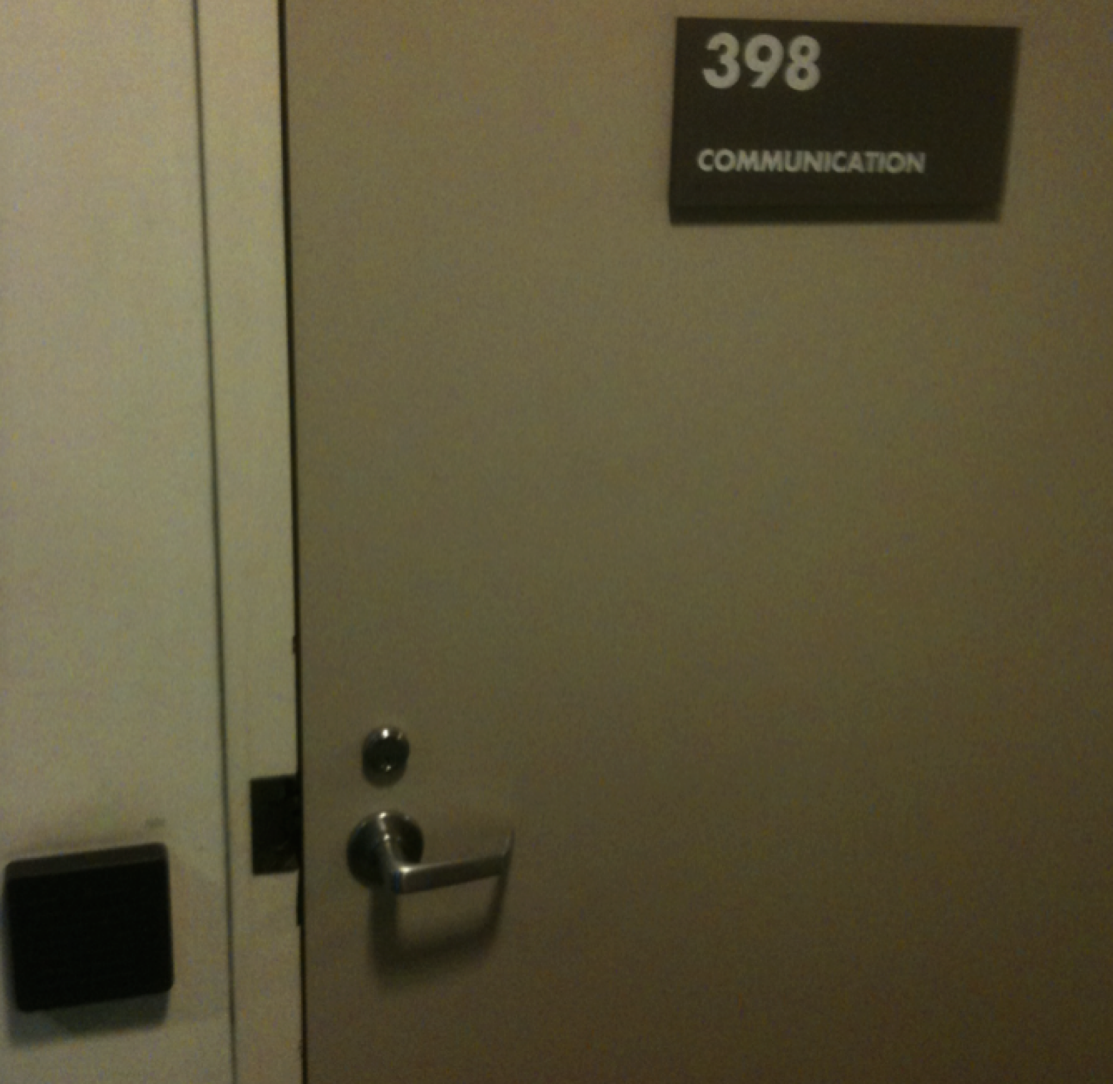
Guarded rooms
The rooms are guarded by electronic card keys
What do you do if the power goes out?
Fail closed: No one can get in if the power is out
Fail open: Anyone can get in if the power goes out
What’s the best option to choose for closets with expensive equipment? What about emergency exit doors?
Takeaway: Use fail-safe defaults

Slide 70
Security Principle: Use Fail-Safe Defaults
Choose default settings that “fail safe,” balancing security with usability when a system goes down
This can be hard to determine

Slide 71
Design in Security from the Start

Slide 72
Security Principle: Design in Security from the Start
When building a new system, include security as part of the design considerations rather than patching it after the fact
A lot of systems today were not designed with security from the start, resulting in patches that don’t fully fix the problem!
Keep these security principles in mind whenever you write code!

Slide 73
Security Principles: Summary
Know your threat model: Understand your attacker and their resources and motivation
Consider human factors: If your system is unusable, it will be unused
Security is economics: Balance the expected cost of security with the expected benefit
Detect if you can’t prevent: Security requires not just preventing attacks but detecting and responding to them
Defense in depth: Layer multiple types of defenses
Least privilege: Only grant privileges that are needed for correct functioning, and no more
Separation of responsibility: Consider requiring multiple parties to work together to exercise a privilege
Ensure complete mediation: All access must be monitored and protected, unbypassable
Shannon’s maxim: The enemy knows the system
Use fail-safe defaults: Construct systems that fail in a safe state, balancing security and usability.
Design in security from the start: Consider all of these security principles when designing a new system, rather than patching it afterwards

